Slide 1
Fault rupture between two dissimilar semi-infinite half-spaces with constant friction law
Advances in Contact Mechanics - ME-623
Ankit Gupta, Mahmoud Shaqfa
Prof. Jean-François Molinari (LSMS)

Slide 2
Types of waves (Animation & Links):
https://www.acs.psu.edu/drussell/demos/waves/wavemotion.html
http://www.maths.nuigalway.ie/~destrade/Publis/destrade_chapter_book_10.pdf
(refer to [1])
http://www.maths.nuigalway.ie/~destrade/Publis/

Slide 3
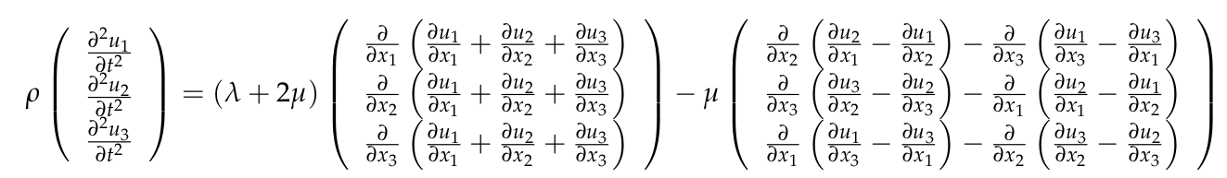

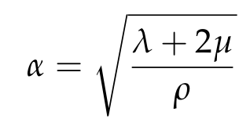
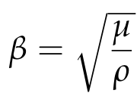
Seismic waves (Navier-Cauchy equation) [2, 3]:
P-wave
S-wave

Slide 4
Ellipse parametric equation:
https://www.mathopenref.com/coordparamellipse.html
https://math.stackexchange.com/questions/1126121/defining-the-equation-of-an-ellipse-in-the-complex-plane

Slide 5
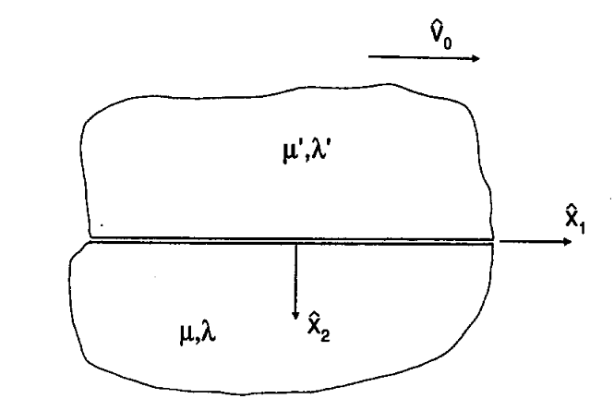


Assumptions:
Isotropic linear elastic material.
No separation - no openings along the interface.
Constant friction – Coulomb criteria.
Body waves (S- and P- waves) are considered.
“Linear elasticity is valid for the short time scale involved in the propagation of seismic waves.” (see [2])
Two semi-infinite halves
(refer to [3])

Slide 6

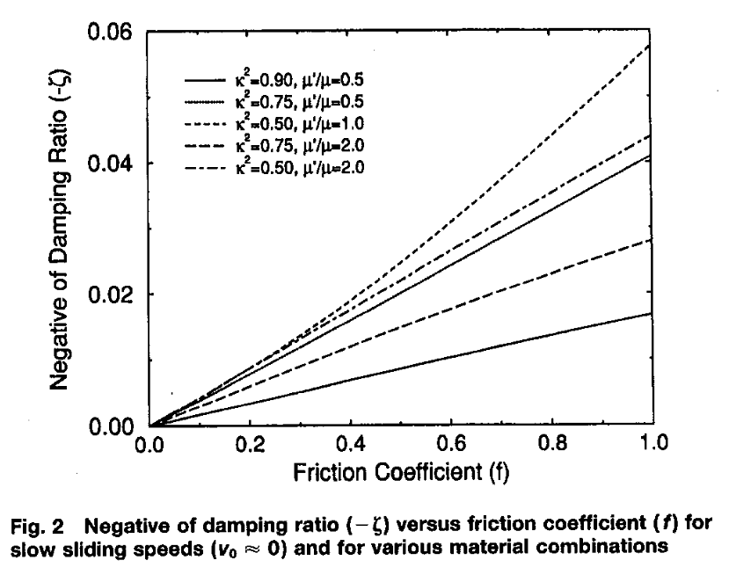
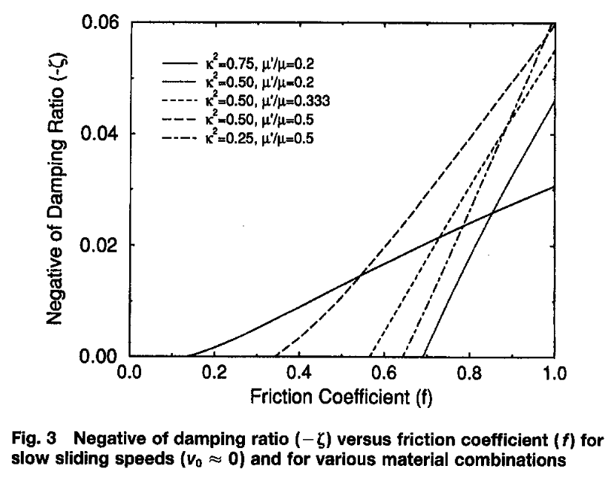
Generalized Rayleigh waves (to be or not to be!)
Stonely frictionless waves exist (slip waves)
Stonely frictionless doesn’t exist

Slide 7
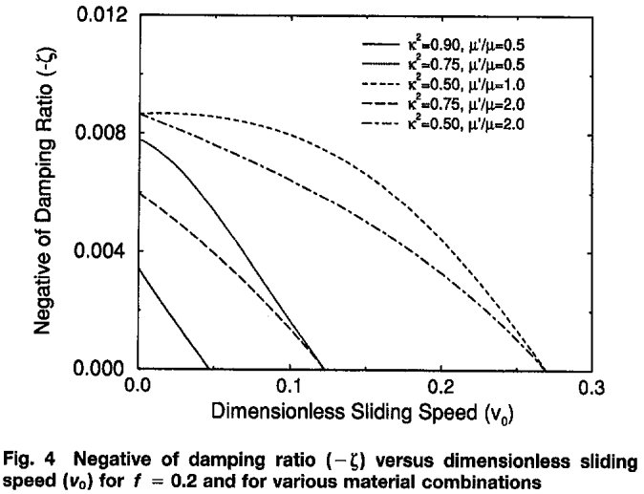
Large materials contrast (refer to [3])

Slide 8
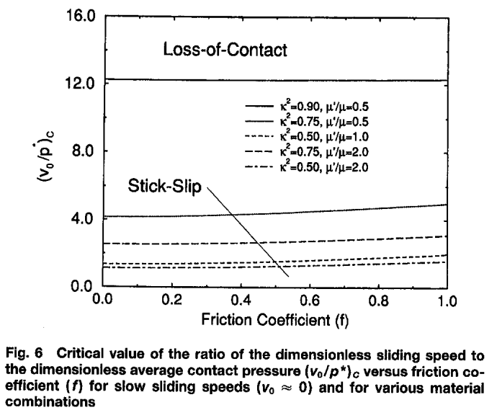

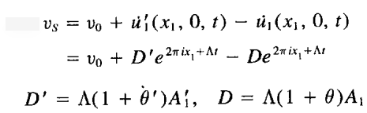
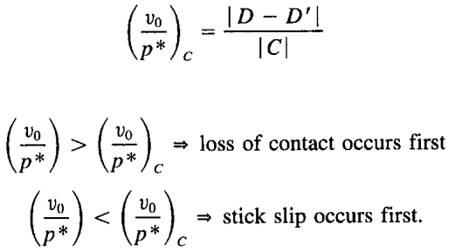
Critical values of dynamic stability (Adam’s Stability)

Slide 9
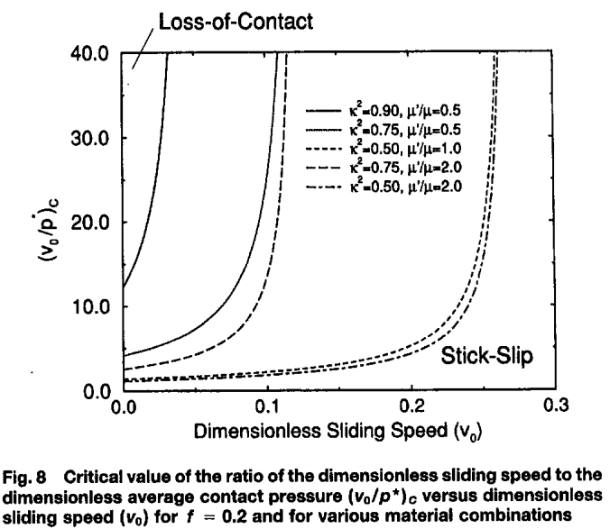
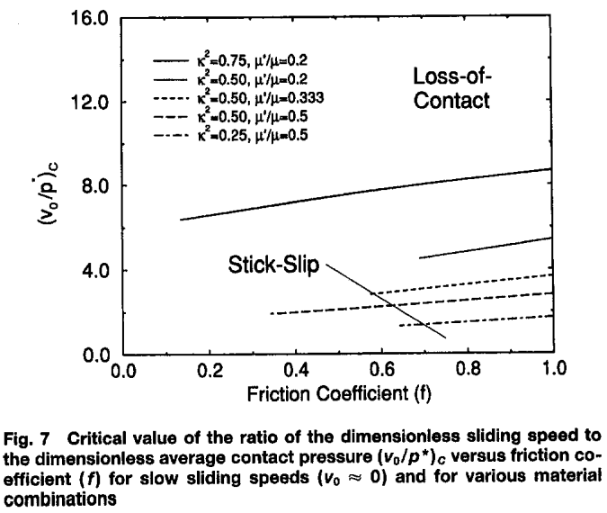
Critical values of dynamic stability (Adam’s Stability)

Slide 10
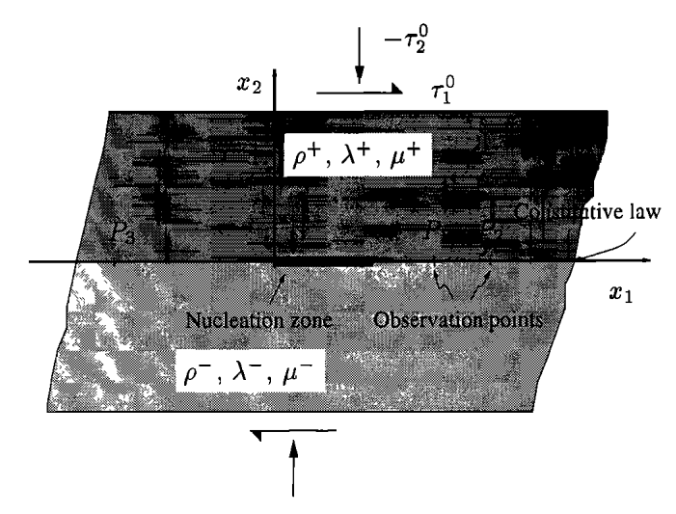
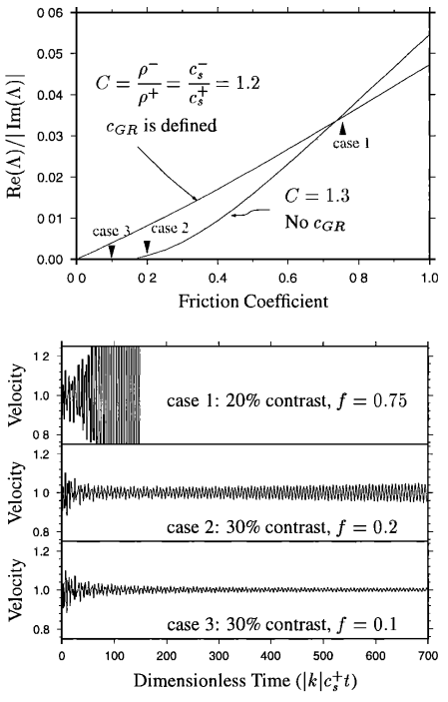
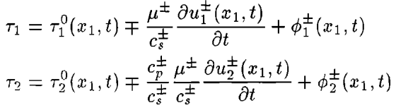
Numerical ill-posedness, and regularization (see [4])
Adams stability [Adams 1995]

Slide 11
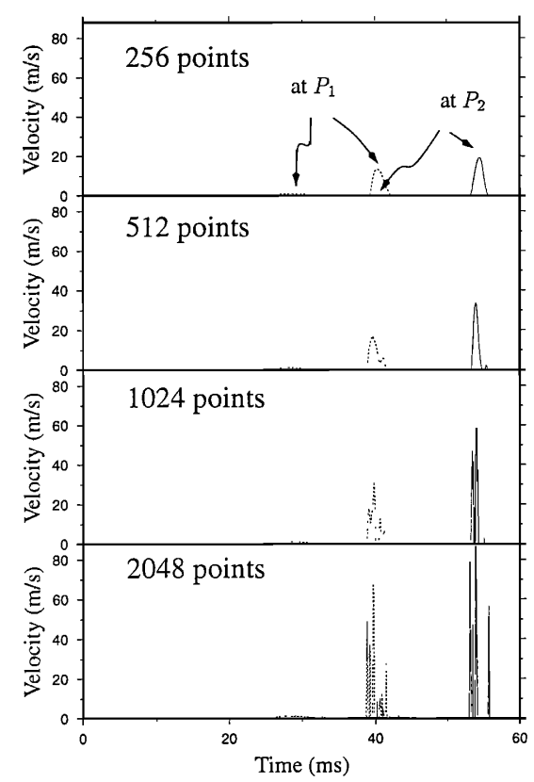
Numerical ill-posedness, and regularization (see [4])
Coulomb law – constant friction

Slide 12
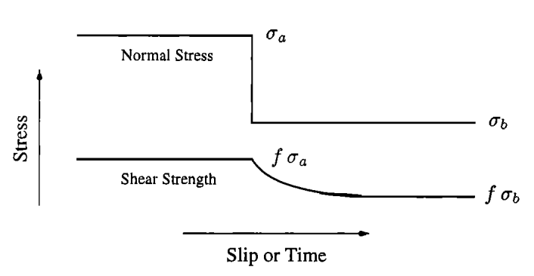
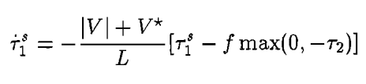
Numerical ill-posedness and regularization (see [4])
Prakash-Clifton experimental law

Slide 13
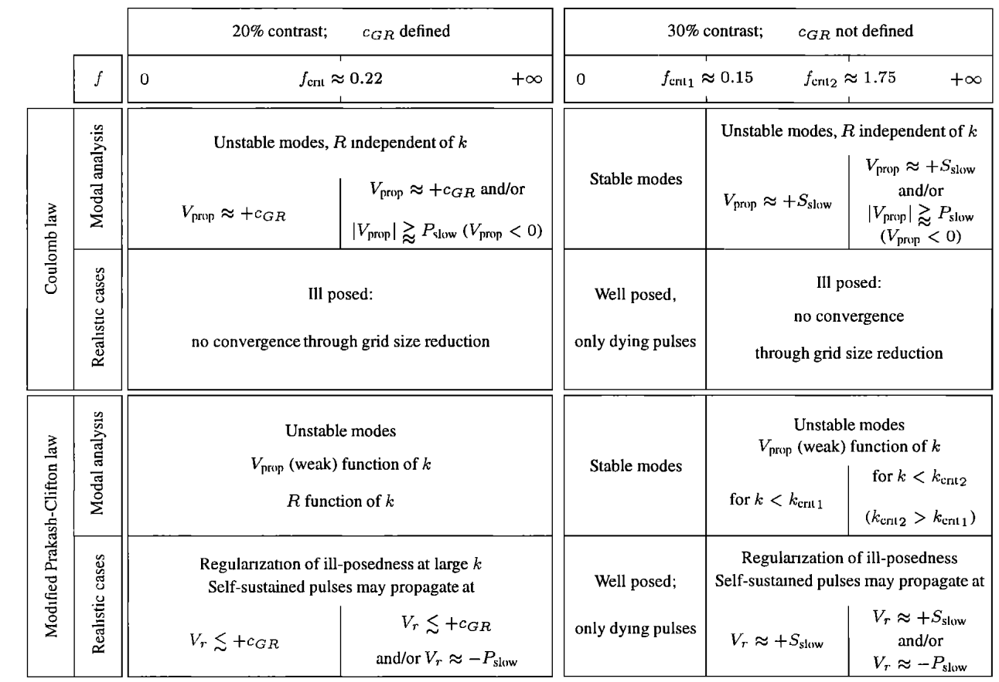
Numerical ill-posedness, and regularization (see [4])
Ranjith and Rice (RR) [2000]
Ranjith and Rice (RR) [2000]

Slide 14
References
[1] - M. Destrade, G. Saccomandi. Linear elastodynamics and waves. Continuum Mechanics (J. Merodio & G. Saccomandi, Editors). Encyclopedia of Life Support Systems (EOLSS), Developed under the Auspices of the UNESCO, Eolss Publishers, Oxford, UK-II (2012) 1-31.
[2] - Shearer, P. (2009). Introduction to seismology (Second edition.). Cambridge: Cambridge University Press.
[3] - Adams, George. (1995). Self-Excited Oscillations of Two Elastic Half-Spaces Sliding With a Constant Coefficient of Friction. Journal of Applied Mechanics-transactions of The Asme - J APPL MECH. 62. 10.1115/1.2896013.
[4] - Cochard, Alain & Rice, James. (2000). Fault rupture between dissimilar materials: Ill-posedness, regularization, and slip-pulse response. Submitted to the Journal of Geophysical Research. 105. 10.1029/2000JB900230.

Slide 15
Deriving the equation of elastic waves:
Navier-Cauchy equation and assumptions
http://www.mit.edu/~nnakata/page/Teaching_files/GEOPHYS130/GEOPHYS130_notes_all.pdf

